Slide 1
Navajo Nation COVID-19
File created on: 3/1/2021 10:54:23 PM

Slide 2
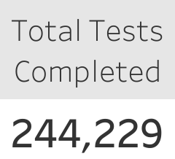

Slide 3
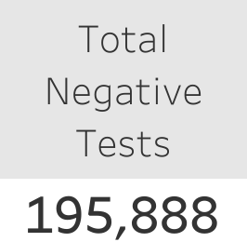

Slide 4
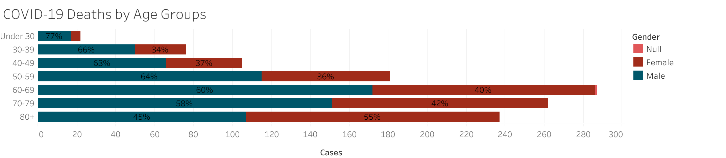

Slide 5
